Slide 1

Student Organization System (SOS)
Armando J. Ochoa –Minute Taker, System Architect
Yovanni Jones – Time Keeper, Tester
Anthony Sanchez-Ayra –Primary Facilitator, Database Administrator
Teriq Douglas – Accountant, Object Designer
M.Kian Maroofi – Team Leader, Front-End developer
Date: 12/03/2019
Notes:
Kian

Slide 2
Purpose and Scope of System
Provide a single point of access to all users to
Check all the organizations they belong to.
Find nearby events hosted by organizations.
Discover new organizations.
Connect with other members.
Manage organization leaders and their privileges.
Create and advertise organization-related events.
Out of Scope:
Social Media Features
Organization finance management.
Notes:
Armando

Slide 3
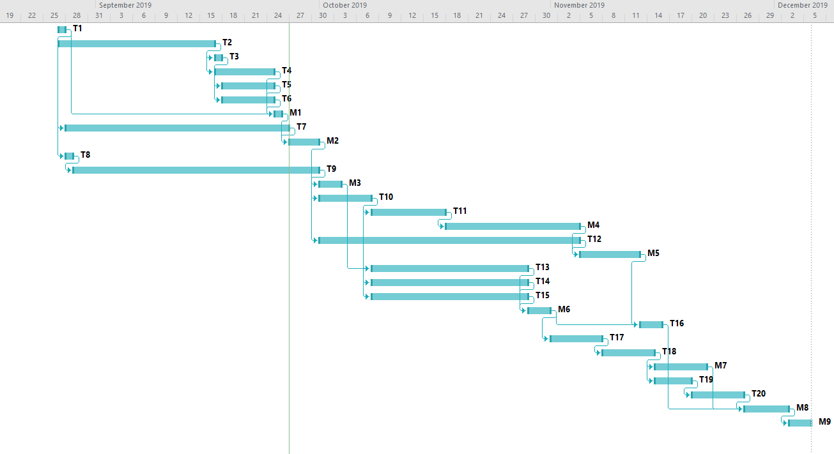
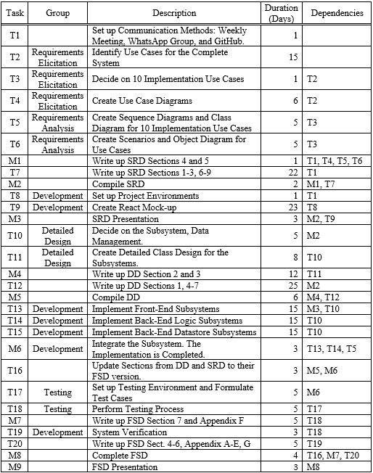
Notes:
Armando

Slide 4
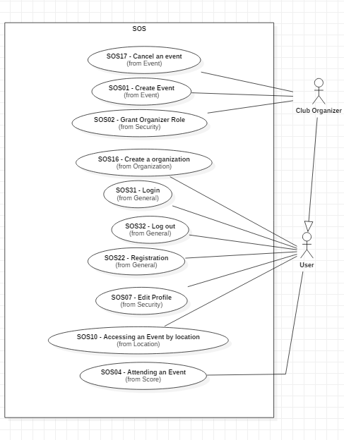
UML Use Case Diagram
Notes:
Yovanni

Slide 5
SOS16 Create Organization Functional Requirements
Preconditions - user is logged in.
Description:
User clicks on “Organization Tab.”
The webpage switches to Organization page.
User click on “Create Organization.”
User then fills out form asking for the Organization details.
User submits form to the Organization page.
Postconditions – user becomes Club Organizer for the Organization.
Notes:
Yovanni

Slide 6
SOS16 Create Organization Nonfunctional Requirements
Usability:
2 minutes to complete the request.
Reliability:
Mean time to failure – 5% monthly.
Performance:
200 requests per min and process each in 6 sec.
Criticality:
High. Main purpose of the system.
Frequency:
20 organization requests monthly.
Notes:
Yovanni

Slide 7
SOS07 Edit Profile Functional Requirements
Preconditions:
User is logged in.
Description:
User clicks “Edit Profile.”
User is shown an editable form.
User inputs the data and submits the request.
The webpage request the user’s password.
System authenticates their request.
Postconditions:
User data has been updated on the data storage.
Notes:
Kian

Slide 8
SOS07 Edit Profile Nonfunctional Requirements
Usability
20 sec to find and complete use case.
Reliability
Mean Time to Failure – 5% monthly.
Performance
20 checks per min and process each ~2 sec.
Criticality
Low. Secondary feature of the system.
Frequency:
20 profile edits per week.
Notes:
Kian

Slide 9
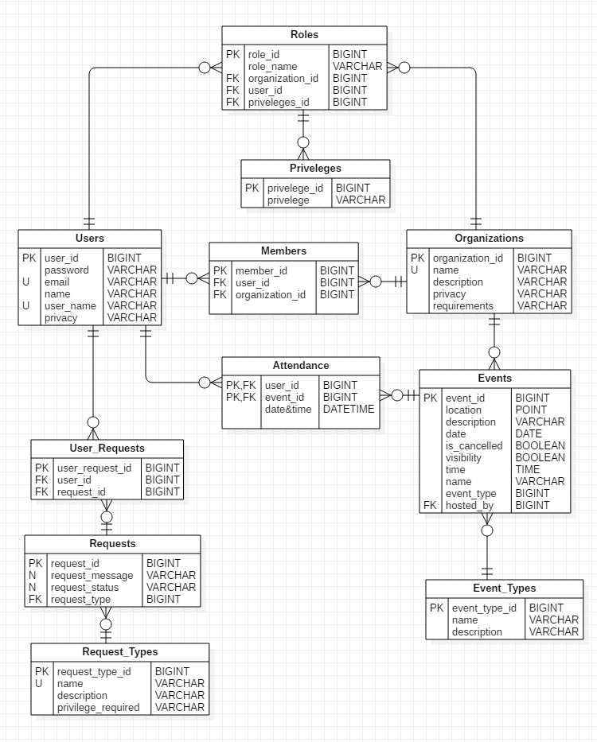
Data Management

Slide 10
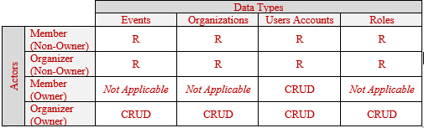
Security & Privacy: Data Management
Notes:
Armando

Slide 11
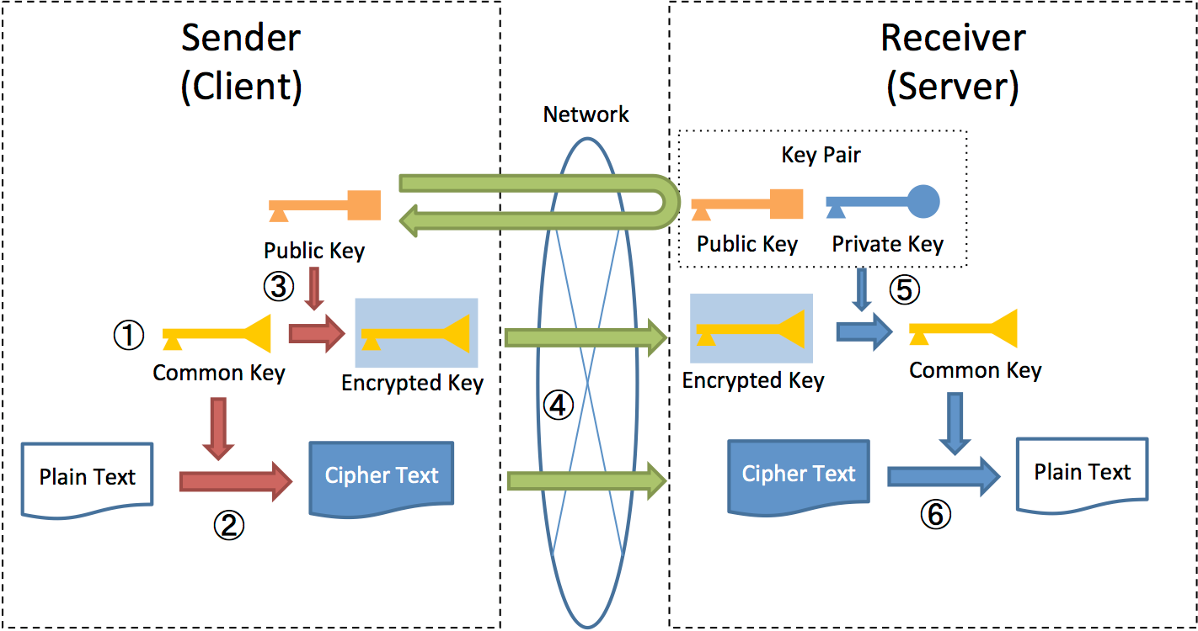
Security & Privacy: Encryption
Notes:
Armando

Slide 12
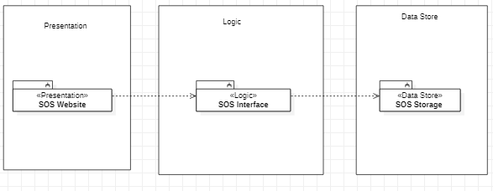
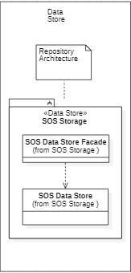
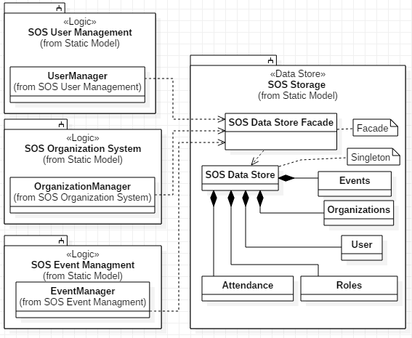
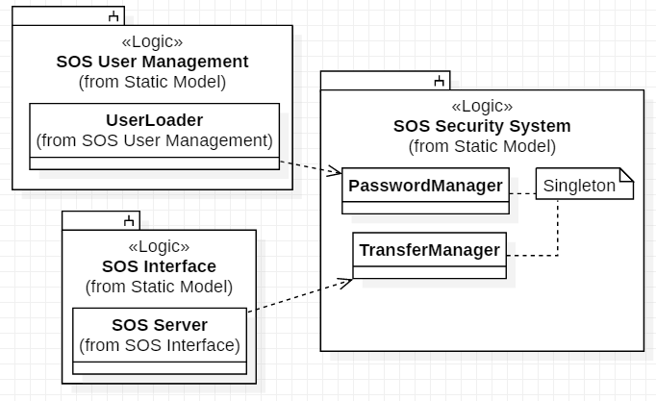
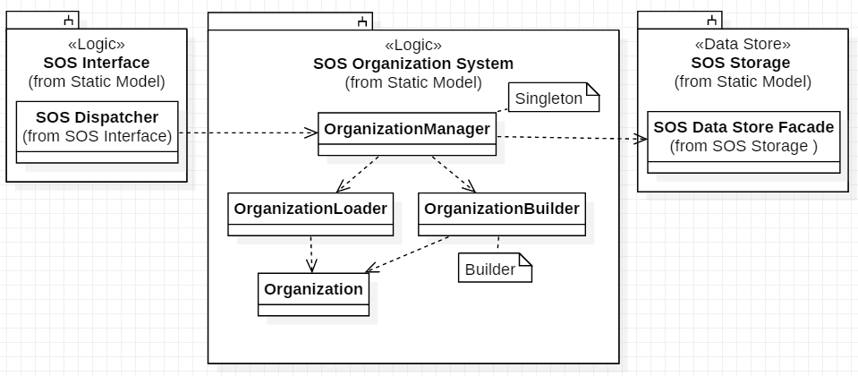
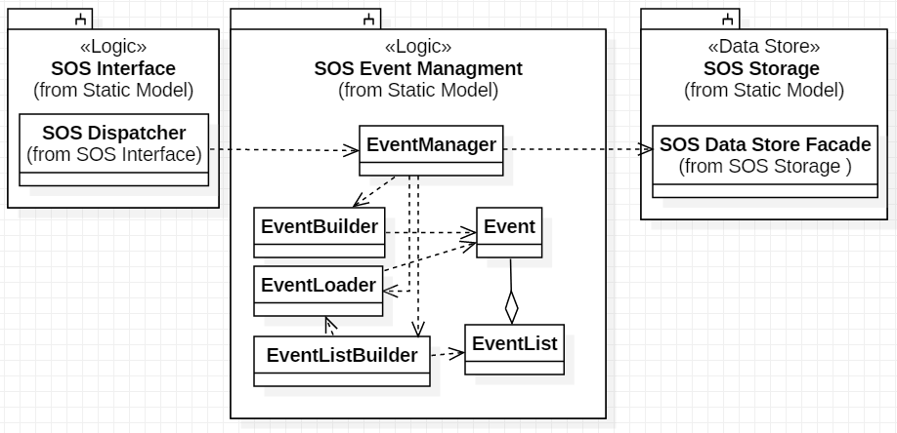
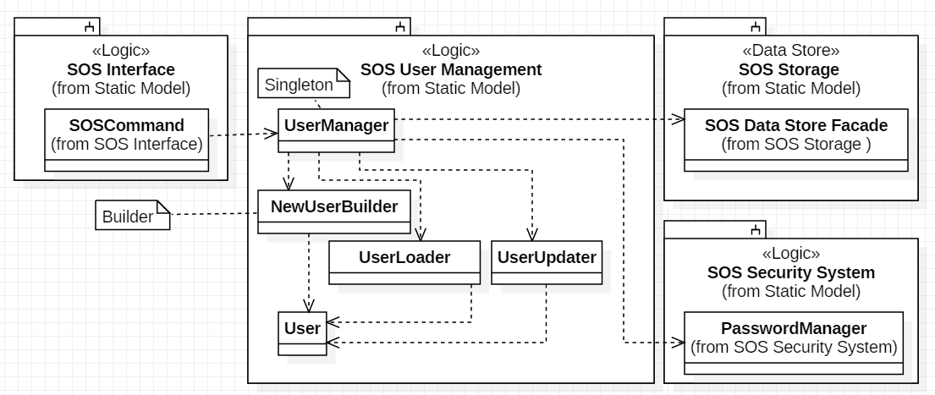
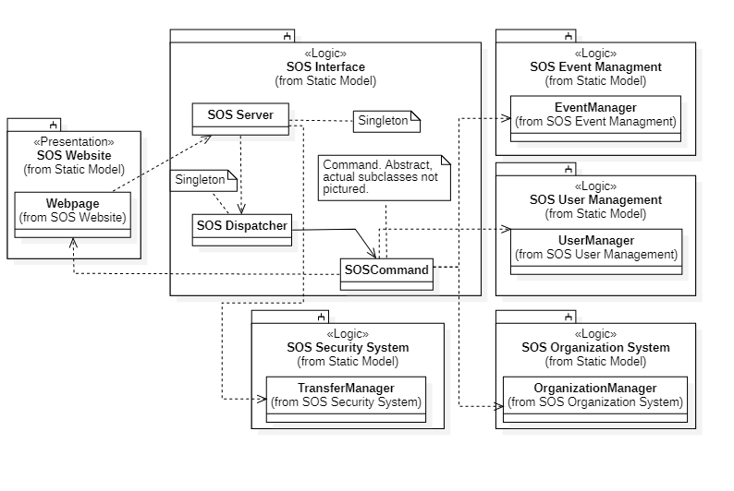
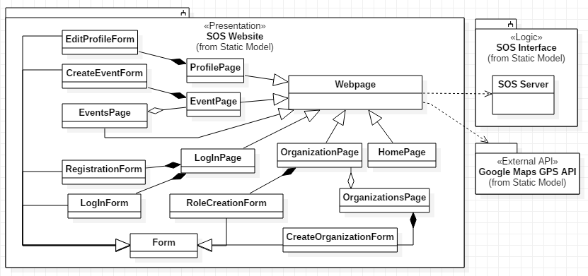
Minimal Class Diagram
Notes:
Needs to be updated
Anthony

Slide 13
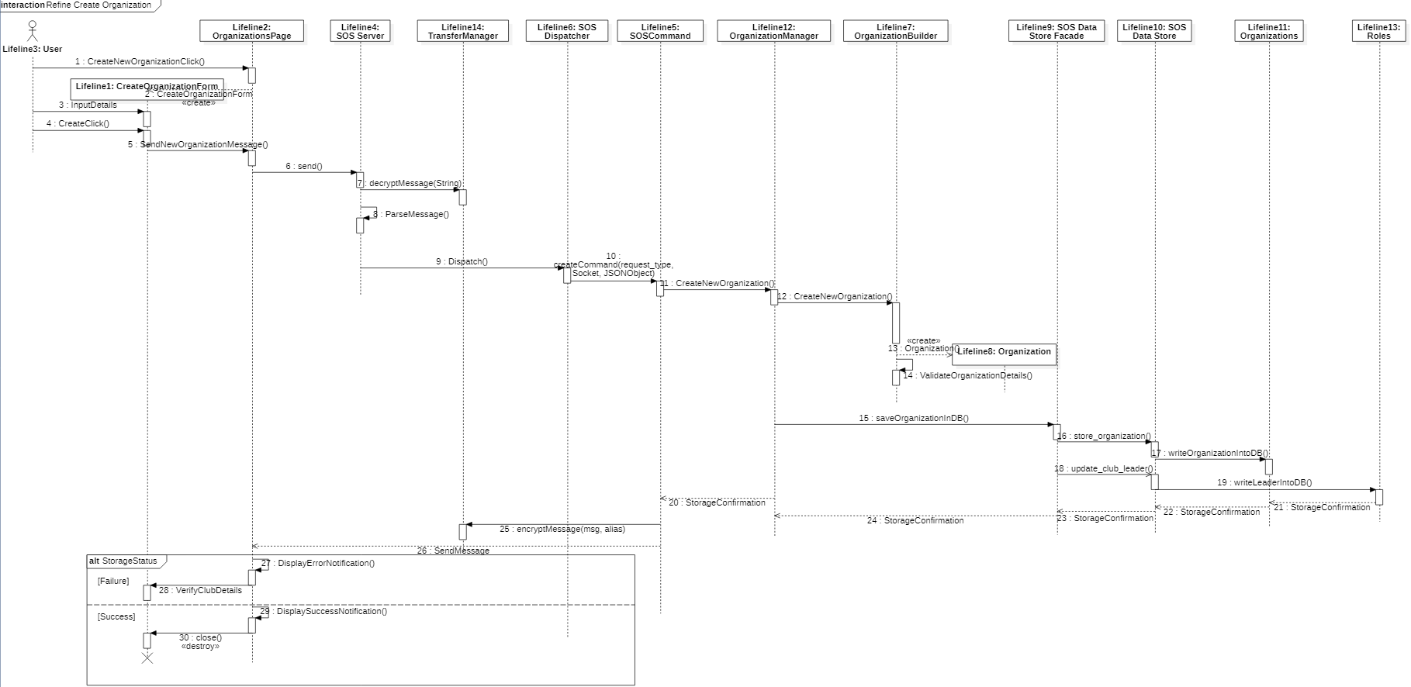
Sequence Diagram SOS16 Create Organization
Notes:
Anthony

Slide 14
Test Case: SOS07-System-**-Sunny**
Purpose: Ensure that a Profile that exists in SOS is able to have its email address changed.
Test set-up: There is already a user who has made a profile within the system.
Input:
From profile page the user will click on the ‘edit profile’ button.
Then a form will pop up that has information she had already inserted before.
She inserts the change into the email field, erasing style@hotmail.com and typing in fab@gmail.com
She will click the “submit” button.
She will enter her password.
Expected Output: The SOS system display a success pop-up and displays the new email to the user.
Notes:
Kian

Slide 15
Test Case: SOS07-System-**-Rainy**
Purpose: Test how the system will react to user attempting to edit their profile but instead cancels from the form.
Test set-up: User already has a profile on the account.
Input:
1. Clicks on “edit profile” button.
2. Form pops up to shown information that has been inserted before.
3. User realizes that there is actually no mistake and he did enter his number correctly.
4. they presses the “x” button at the upper right corner of the form to close it.
Expected Output: No changes have occurred to profile information. User is back on profile page.
Notes:
Teriq

Slide 16
Test Case: SOS16-System-**-Sunny**
Purpose: Ensure that a user can successfully create an organization on the website
Test set-up: User is logged into her account.
Input:
1. User clicks on “Create Organization” button
2. A form will pop up in front of the screen to enter information
3. User enters data in respective fields: Organization Name = “QRT” ; Description = “Lets study” ; Requirements for Joining = none ; Privacy = “public”
4. She then clicks on the “submit” button
Expected Output: The request is submitted and a pop up about the Organization will appear before the user.
Notes:
Teriq

Slide 17
Test Case: SOS16-System-**-Rainy**
Purpose: Test to ensure that all Organization details must be filled out to be stored in SOS.
Test set-up: User has an account and is on the organization page.
Input:
1. They click on the “Create Organization” button
2. A form pops up to fill out required information
3. She enters the following data: Organization Name = “My special club”
4. Then she clicks the “submit” button
Expected Output: A pop up message will appear in front of the user saying that some of the required fields have not been filled out.
Notes:
Teriq

